Slide 1
Newtons laws of motion and its application

Slide 2
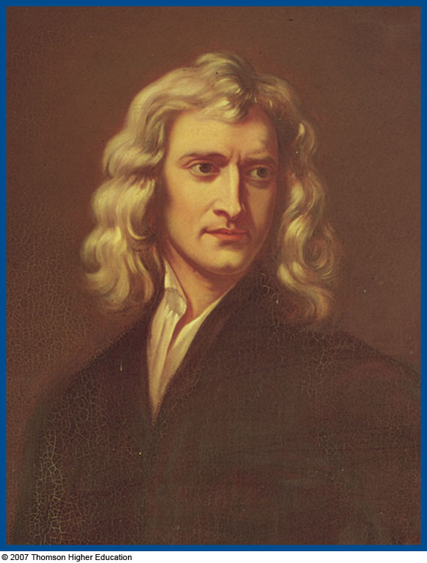
Sir Isaac Newton
1642 – 1727
Formulated basic laws of mechanics
Discovered Law of Universal Gravitation
Invented form of calculus
Many observations dealing with light and optics

Slide 3
Force
Forces are what cause any change in the velocity of an object
Newton’s definition
A force is that which causes an acceleration

Slide 4
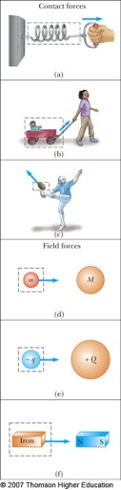
Classes of Forces
Contact forces involve physical contact between two objects
Examples a, b, c
Field forces act through empty space
No physical contact is required
Examples d, e, f

Slide 5
Fundamental Forces
Gravitational force
Between objects
Electromagnetic forces
Between electric charges
Nuclear force
Between subatomic particles
Weak forces
Arise in certain radioactive decay processes
Note: These are all field forces

Slide 6
Fundamental Forces
Physicists have traditionally identified four basic forces:
(1) the gravitational force
(2) the electromagnetic force
(3) the weak nuclear force, which causes certain radioactive decay processes and certain reactions among the fundamental particles.
(4) the strong force, which operates among the fundamental particles and is responsible for binding the nucleus together.

Slide 8
Two protons in typical nucleus, for example, the relative strength of these forces would be:
strong (relative strength = );
electromagnetic( );
weak ( ); gravitational ( ).

Slide 9
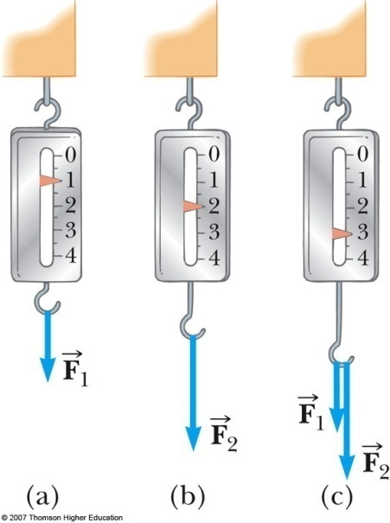
More About Forces
A spring can be used to calibrate the magnitude of a force
Doubling the force causes double the reading on the spring
When both forces are applied, the reading is three times the initial reading

Slide 10

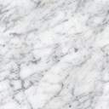
Tension and normal forces
(1) Tension force (such as in a stretched rope or string), arises because each small element of the string pulls on the element next to it.
If the mass of the rope is negligible, the values of the force exerted on the two ends of the rope must be nearly equal to each other.

Slide 11
(2) Normal force : Just like tension force, the normal force is also contact force.
Both tension and normal forces originate with the atoms of each body --- each atom exerts a force on its neighbor. They belong to electromagnetic forces.

Slide 12
Friction forces
Friction is the force that opposes the relative motion or the trend of relative motion of two solid surfaces in contact
static friction
Friction
sliding friction
√
kinetic friction
rolling friction
1) The forces of static friction
The frictional forces acting between surfaces at rest with respect to each other.

Slide 13
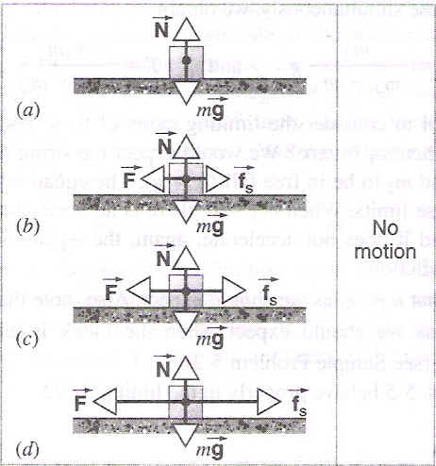
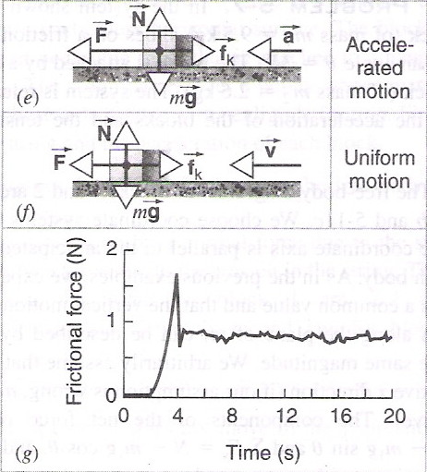
Friction force can be measured by following expt.
Fig 5-12 Friction force
f_{sMax}
rest
moving
The maximum force of static friction will be the same as the smallest applied forces necessary to start motion.

Slide 14
The maximum force of static friction between any pair of dry unlubricated surface follows these two empirical laws :
(1) It is approximately independent of the area of contact surfaces.
(2) It is proportional to the normal force
(5-7)
where N the magnitude of the normal force,
the coefficient of static friction,
the maximum force of static friction.

Slide 15
2)The force of kinetic friction (5-8)
where is the coefficient of kinetic friction.
Usually, for a given pair of surfaces . The actual value of and depend on the nature of both the surfaces in contact.

Slide 16
Table 5-1 some representative values of and .
Surface
Rubber on dry concrete | 1.0 | 0.8
Glass on glass | 0.9 ~ 1.0 | 0.4
Steel on steel | 0.6 | 0.6
Wood on wood | 0.25 ~ 0.5 | 0.2
Waxed wood ski on dry snow | 0.04 | 0.004

Slide 17
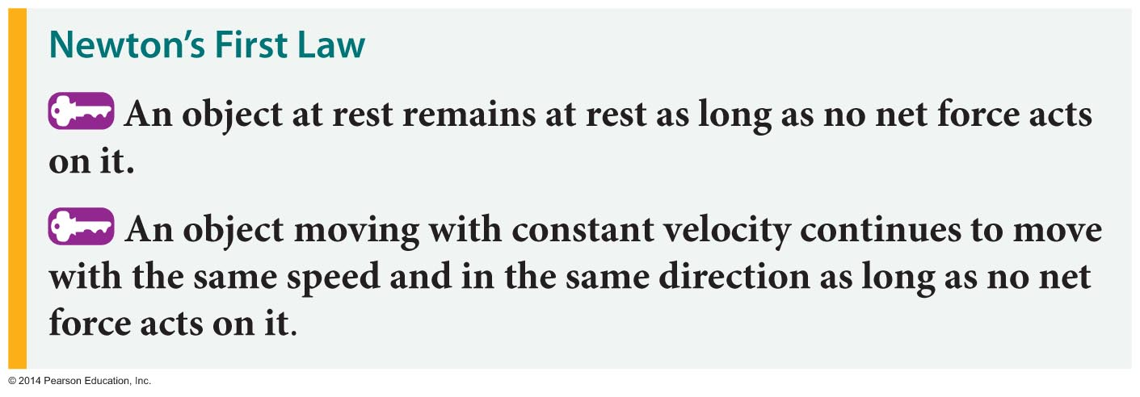
Newton's Laws of Motion
Objects don't start or stop moving on their own.
This observation is the essence of Newton's first law of motion:

Slide 18
Particles in Equilibrium
If the acceleration of an object that can be modeled as a particle is zero, the object is said to be in equilibrium
The model is the particle in equilibrium model
Mathematically, the net force acting on the object is zero

Slide 19
Inertial Frames
Any reference frame that moves with constant velocity relative to an inertial frame is itself an inertial frame
A reference frame that moves with constant velocity relative to the distant stars is the best approximation of an inertial frame
We can consider the Earth to be such an inertial frame, although it has a small centripetal acceleration associated with its motion

Slide 20
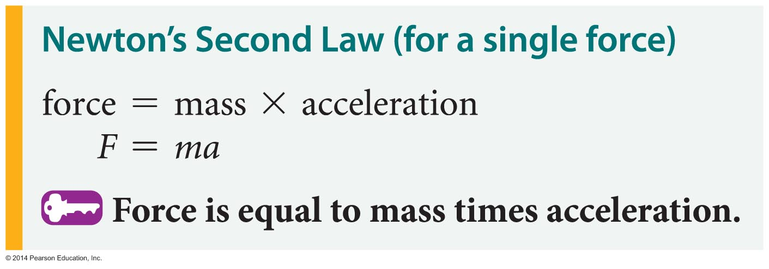
Newton's Laws of Motion
Rearranging the equation yields a form of Newton's second law that is perhaps best known, F equals m times a:

Slide 21
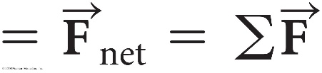

Newton's Laws of Motion
The second law also applies to situations in which several forces are acting on an object.
When several forces act on an object, the F in the equation F = ma is replaced with the sum of the force vectors:
sum of force vectors
The notation is read "sum of the forces."

Slide 22
More About Newton’s Second Law
is the net force
This is the vector sum of all the forces acting on the object
Newton’s Second Law can be expressed in terms of components:
ΣF_{x} = m a_{x}
ΣF_{y} = m a_{y}
ΣF_{z} = m a_{z}

Slide 23
Newton's Laws of Motion
The unit of force used is the newton (N).
A newton is defined as the force required to give a mass of 1 kilogram an acceleration of 1 m/s² .
A newton is roughly equivalent to a quarter of a pound.
The table below gives the magnitudes of some common forces.

Slide 24
Inertia and Mass
The tendency of an object to resist any attempt to change its velocity is called inertia
Mass is that property of an object that specifies how much resistance an object exhibits to changes in its velocity
Masses can be defined in terms of the accelerations produced by a given force acting on them:
The magnitude of the acceleration acting on an object is inversely proportional to its mass.

Slide 25
More About Mass
Mass is an inherent property of an object
Mass is independent of the object’s surroundings
Mass is independent of the method used to measure it
Mass is a scalar quantity
The SI unit of mass is kg

Slide 26
More About Weight
Because it is dependent on g, the weight varies with location
g, and therefore the weight, is less at higher altitudes
This can be extended to other planets, but the value of g varies from planet to planet, so the object’s weight will vary from planet to planet
Weight is not an inherent property of the object

Slide 27
Newton's Laws of Motion
According to Newton's third law:
Forces always come in pairs. That is, there are no isolated forces in the universe.
The forces in a pair are equal in magnitude and opposite in direction.
The forces in a pair act on different objects.
The third law is commonly stated in an abbreviated form: For every action, there is an equal and opposite reaction.

Slide 28
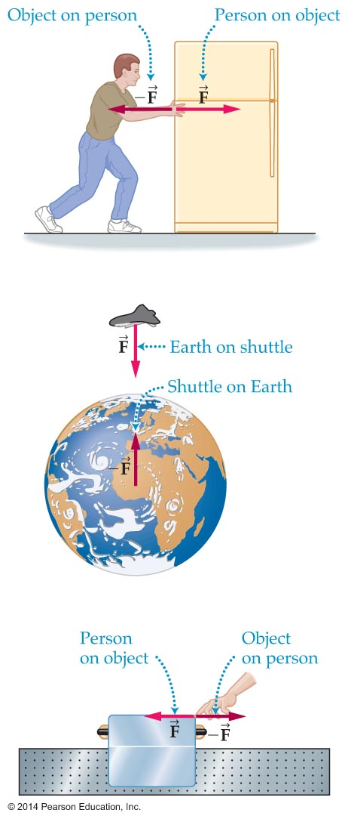
Newton's Laws of Motion
The figure below shows some examples of action-reaction pairs.
Note that in the three examples in the figure, the paired action-reaction forces act on different objects. As a result, the two forces do not cancel.

Slide 29
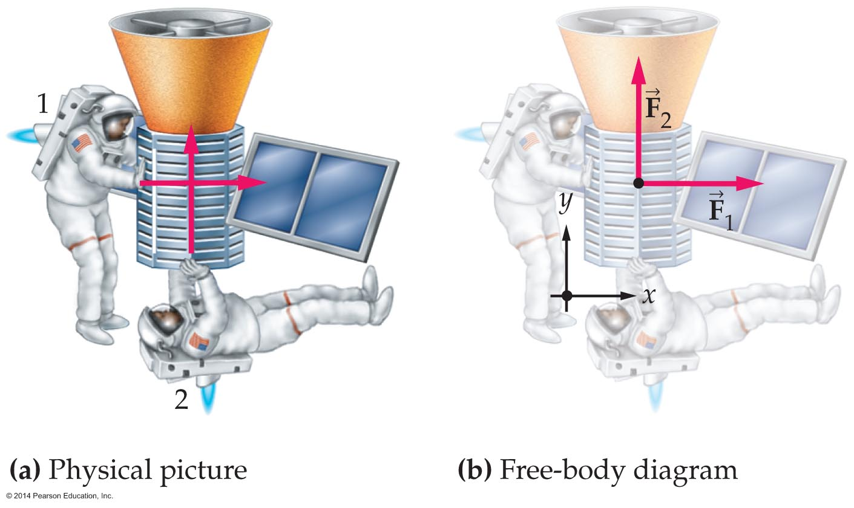
Applying Newton's Laws
Free-body diagrams are useful in applying Newton's laws.
A free-body diagram is a drawing that shows all the forces acting on an object.
To simply a real-life situation, in a free-body diagram the object is often represented as a point.

Slide 30
Application of Newton’s law
Problems

Slide 31
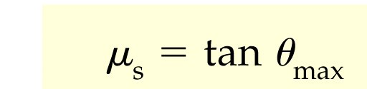
Maximum angle block remains at rest:
Derive the Angle of Repose relation:

Slide 32
Pulleys
The string and the pulley are both massless,
There is no friction where the pulley turns on its axle
Working with ropes and pulleys
For massless ropes or strings and massless, frictionless pulleys:
If a force pulls on one end of a rope, the tension in the rope equals the magnitude of the pulling force.
If two objects are connected by a rope, the tension is the same at both ends.
If the rope passes over a pulley, the tension in the rope is unaffected

Slide 33
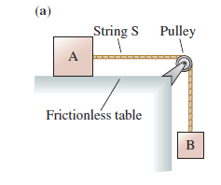
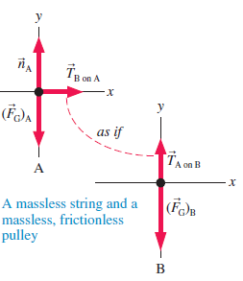

Slide 34
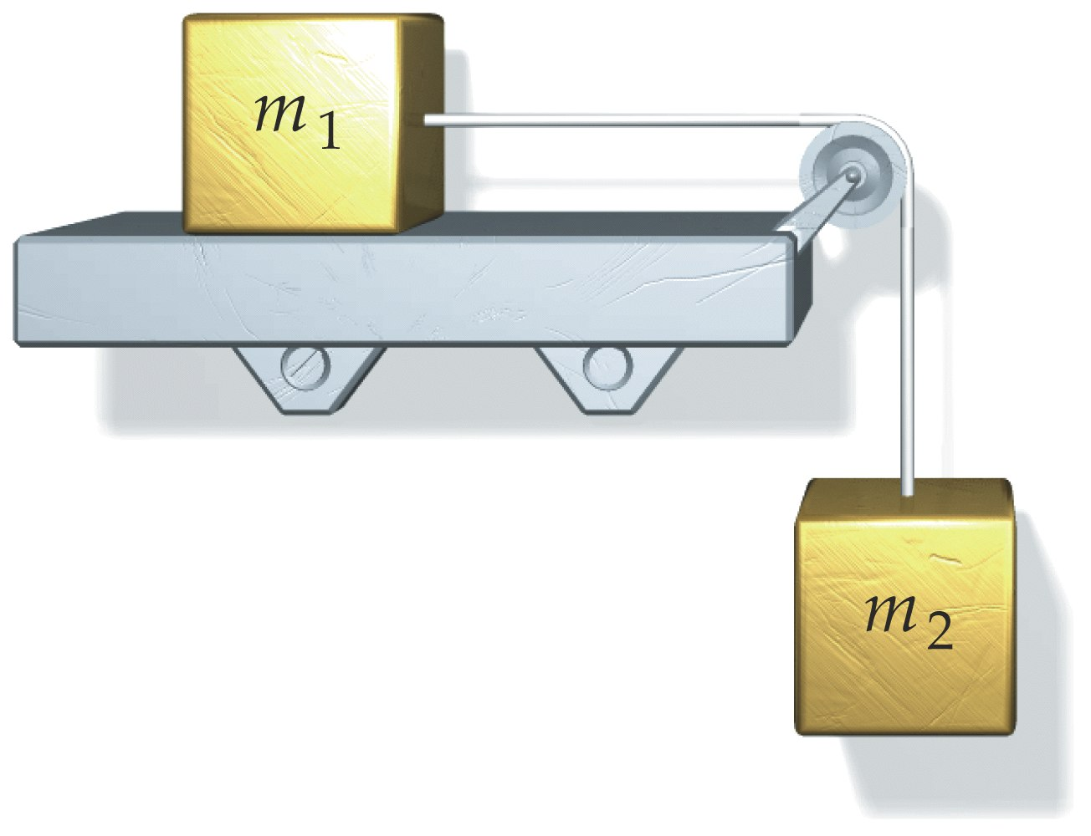
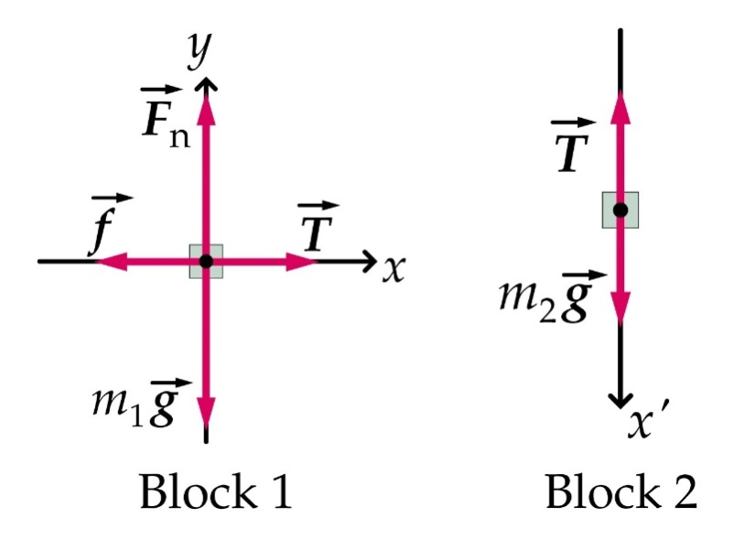
Q. Atwood with Friction. m1=1kg m2=2kg. Kinetic friction = 0.5.

Slide 35
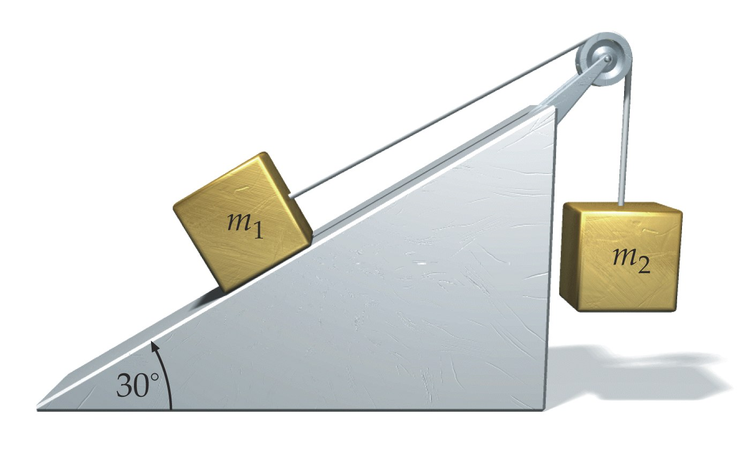

Slide 36
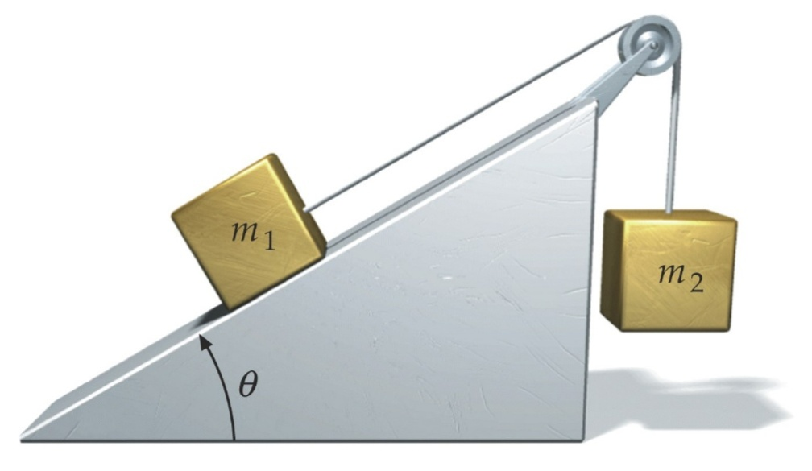
Q.Modified Atwood Machine with friction.
Objects are in CW motion.
Let m1 = 2kg, m2 = 3kg, θ = 30°, sliding friction coeff. 0.44

Slide 37
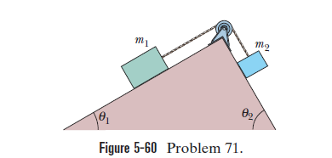
Figure 5-60 shows a box of dirty money (mass m1 3.0 kg)
on a frictionless plane inclined at angle 1 30 . The box is con-
nected via a cord of negligible mass to a box of laundered money
(mass m2 2.0 kg) on a frictionless plane inclined at angleѲ =60 .
The pulley is frictionless and has negligible mass. What is the ten-
sion in the cord?

Slide 38
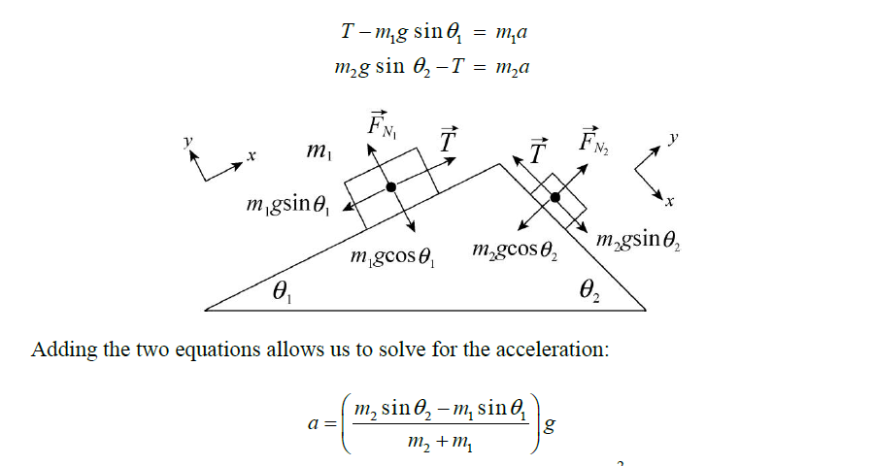


Slide 39
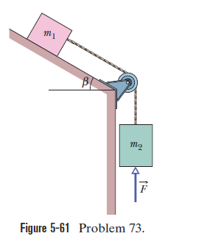
In Fig. 5-61, a tin of antioxidants (m1 1.0 kg) on a fric-
tionless inclined surface is con nected to a tin of corned beef (m2
2.0 kg). The pulley is massless and frictionless. An upward force of
magnitude F 6.0 N acts on the corned beef tin, which has a down-
ward acceleration of 5.5 m/s2. What are (a) the tension in the connecting
cord and (b) angle b?

Slide 40
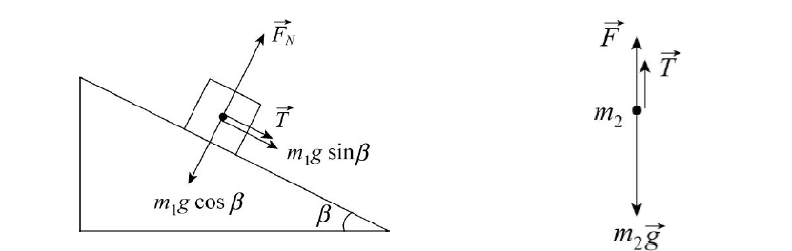

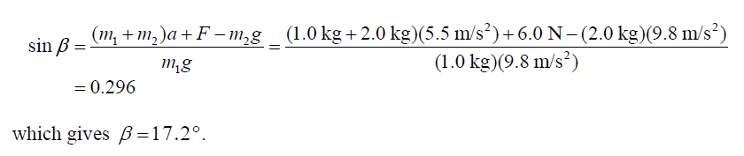

Slide 41
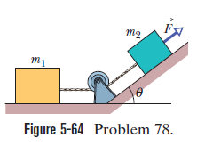
A force of 10 Nnitude 12 N is applied to a FedEx
box of mass m2 1.0 kg. The force is directed up a plane tilted by Ѳ=37 . The box is connected by a cord to a UPS box of mass m1 3.0 kg pulley are frictionless, and the
on the floor. The floor, plane, and masses of the pulley and cord are negligible. What is the tension in
the cord?

Slide 42





Slide 43
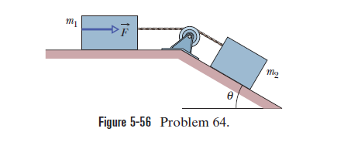
Figure 5-56 shows a box of mass m2 1.0 kg on a fric-
tionless plane inclined at angle u 30 . It is connected by a cord of negligible mass to a box of mass m1 3.0 kg on a horizontal fric- tionless surface. The pulley is frictionless and massless. (a) If the magnitude of horizontal force F is 2.3 N, what is the tension in the:
connecting cord? (b) What is the largest value the magnitude of F
may have without the cord becoming slack?

Slide 44
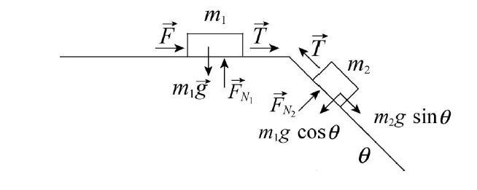


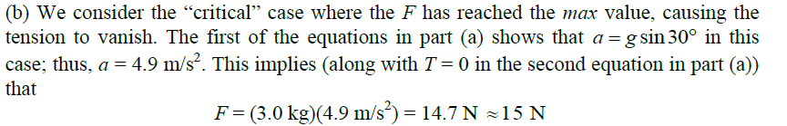

Slide 45
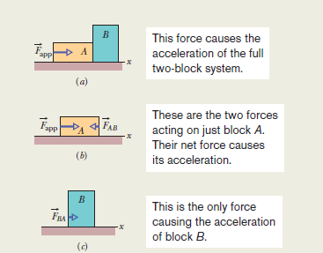

Slide 46



Slide 47
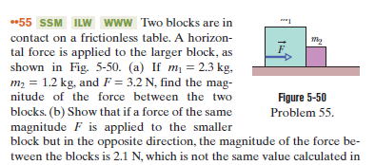

Slide 48
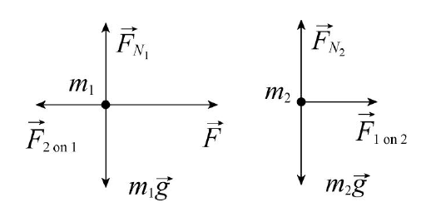
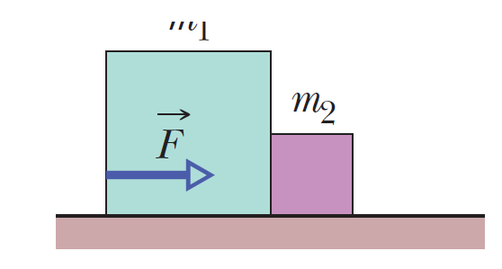





Slide 49
Q. Three boxes are pushed by force F with v > 0 along a horizontal surface with μ_{k} = 0.291.
0
5kg
3kg
2kg
F=26N
f_{k}

Slide 50
Q. A 3kg box at rest on level surface with μ_{s} = 0.55. What is the largest F acting 60° below horizontal for which the box remains at rest?
fs
(60° is close to maximum angle)

